Slide 1

GAYATRI VIDYA PARISHAD COLLEGE OF ENGINEERING – (AUTONOMOUS)
(Affiliated to JNTU-K, Kakinada),VISAKHAPATNAM
DEPARTMENT OF COMPUTER SCIENCE AND ENGINEERING
DEEPFAKE VIDEO DETECTION
USING
NEURAL NETWORKS
Batch No:04
By
P RAVI KUMAR REDDY (20131A05J5)
M V G AASRITHA (20131A05F3)
N N V S S L SIRI VAISHNAVI (20131A05G0)
M VAMSI KRISHNA (20131A05F0)
Under the esteemed guidance of
Name of Project Guide
Ms. P. POOJA RATNAM
Assistant Professor

Slide 2
Abstract
Software & Hardware Requirements
01
06
Implementation
Introduction
07
02
Existing System & It’s Drawbacks
Results Discussion
03
08
Proposed Work
09
Conclusion
04
Block Diagram
10
References
05

Slide 3


ABSTRACT
In recent months, free deep learning-based software tools has facilitated the creation of credible face exchanges in videos that leave few traces of manipulation, in what they are known as "DeepFake"(DF) videos. Manipulations of digital videos have been demonstrated for several decades through the good use of visual effects, recent advances in deep learning have led to a drastic increase in the realism of fake content and the accessibility in which it can be created. These so-called AI synthesized media (popularly referred to as DF).Creating the DF using the Artificially intelligent tools are simple task. But, when it comes to detection of these DF, it is major challenge. Because training the algorithm to spot the DF is not simple. We have taken a step forward in detecting the DF using ResNext Convolutional Neural Network(CNN) and Long short term memory(LSTM)
Problem Statement
To Design and Develop a Deep Learning algorithm to classify the video as deepfake or pristine.

Slide 4
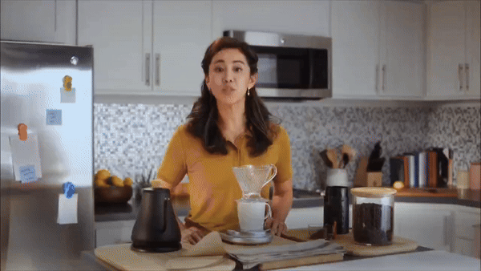
Introduction
Deep fake is a technique for human image synthesis based on artificial intelligence.
Deep fakes are created by combing and superimposing existing images and videos onto source images or videos using a deep learning technique known as Generative Adversarial Network(GAN).

Slide 5
Can we detect Deep fakes with naked eyes?

Slide 6
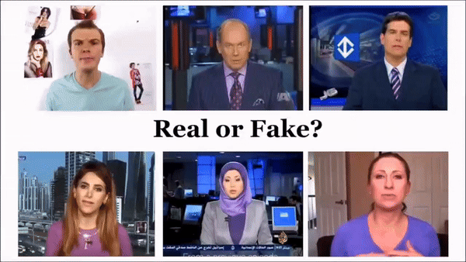

Slide 7
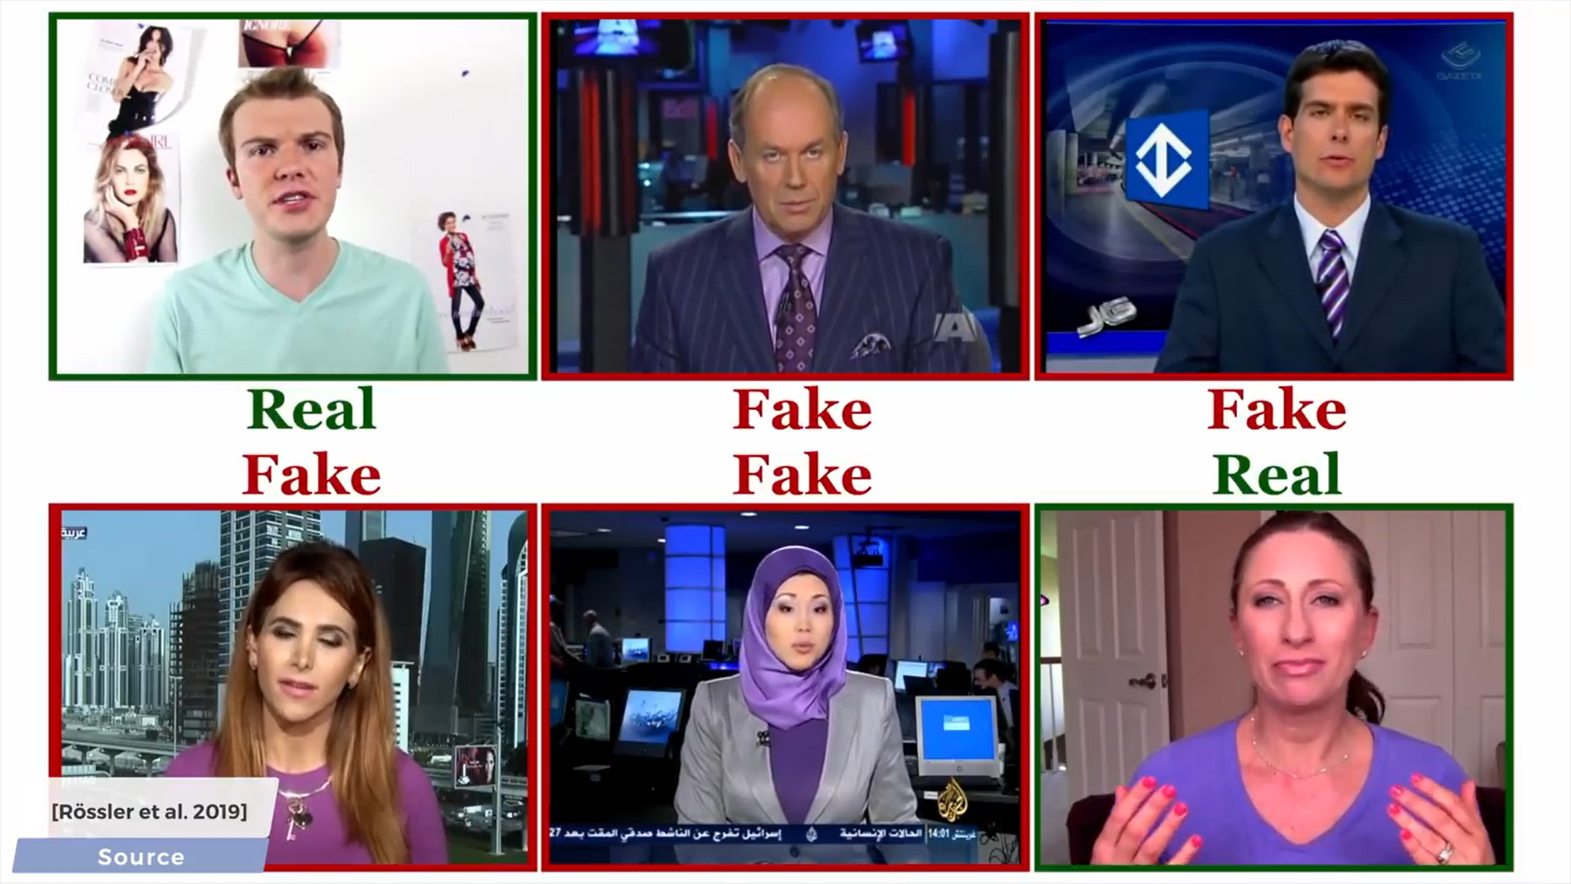

Slide 8
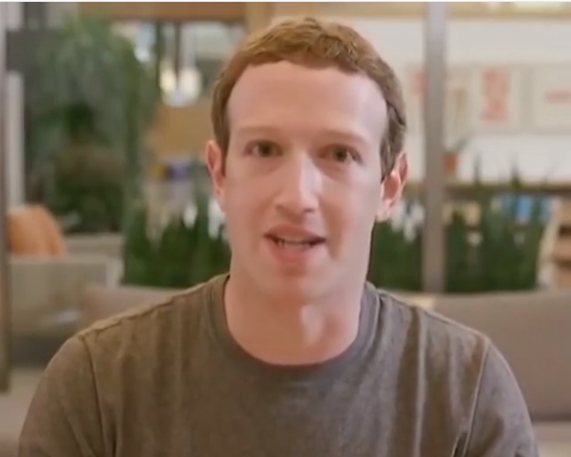
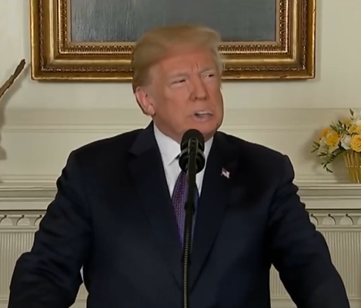
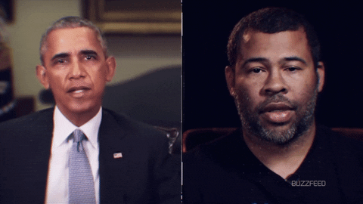
Why Deep Fake Detection ?
Fake News
Malicious hoaxes
Financial fraud
Celebrity unusual video
Revenge porn
Politician videos

Slide 9
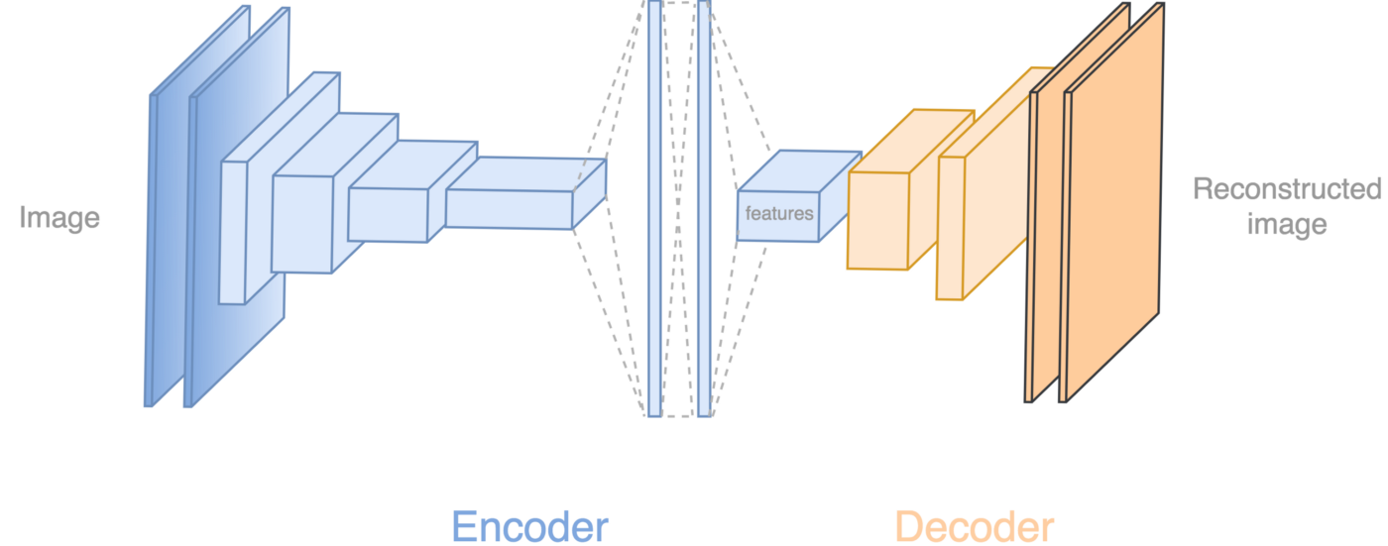
How Deep Fakes Are Created ?
Tools for deep fake creation.
Faceswap
Faceit
DeepFaceLab
DeepfakeCapsuleGAN
Large resolution facemasked

Slide 10
Existing System & It’s drawbacks
EXISTING SYSTEM | DRAWBACKS OF EXISTING SYSTEM
Capsule Networks (CapsNets)[1] | Capsule Networks may require more data for training and may be computationally intensive.
Generative Adversarial Networks (GANs) for Counter-Deepfakes[2] | The arms race between deepfake generators and detectors can lead to continuous improvements on both sides.
Face X-Ray for Deepfake Detection[3] | It may not be as robust to variations in deepfake generation techniques.
Other DeepFake detection Models | Some early approaches analyzed individual frames independently, overlooking temporal inconsistencies that LSTM later addressed effectively.
 | Few detectors can not accept long length videos.

Slide 11
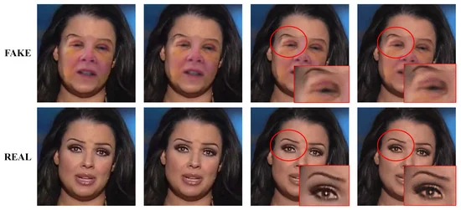
Proposed Work
A frame-by-frame analysis of deepfake videos reveals the inconsistencies between consecutive frames in deepfake videos, which are absent in pristine videos.
These inconsistencies include:
1. A sudden change in brightness and contrast on a small region of the face.
2. The size of some facial parts such as eyes, lips, and eyebrows changes between frames. Also finding artifacts.
we developed a new deepfake detection method, ResNext CNN for Feature Extraction and LSTM for Sequence Processing , that can account for these inconsistencies for the identification of real and fake videos.

Slide 12
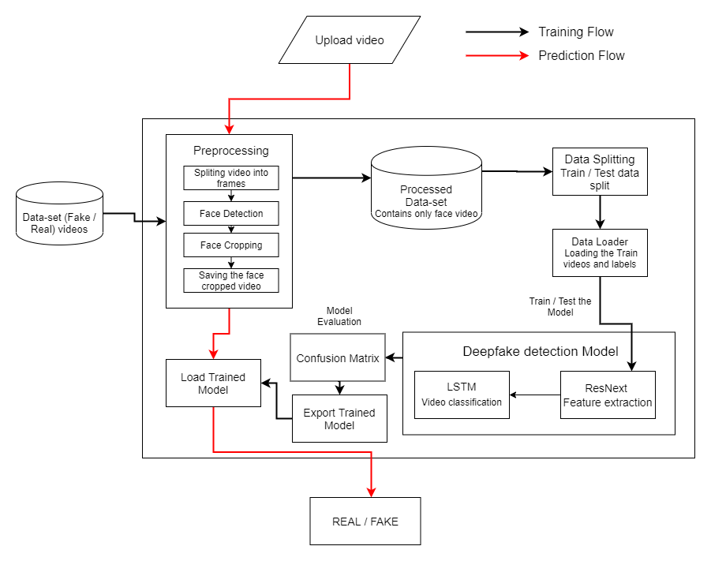

Block Diagram

Slide 13














Programming Languages
Python3
JavaScript
Programming Frameworks
PyTorch
Django
Software & Hardware Requirements
IDE
Google
Jupyter Notebook
Visual Studio Code
Cloud Services
Google Cloud Platform
Version Control
Git

Slide 14
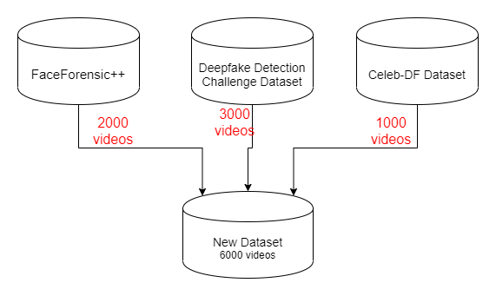

Data Set
Exploration
Implementation
[4]
[5]
[6]

Slide 15
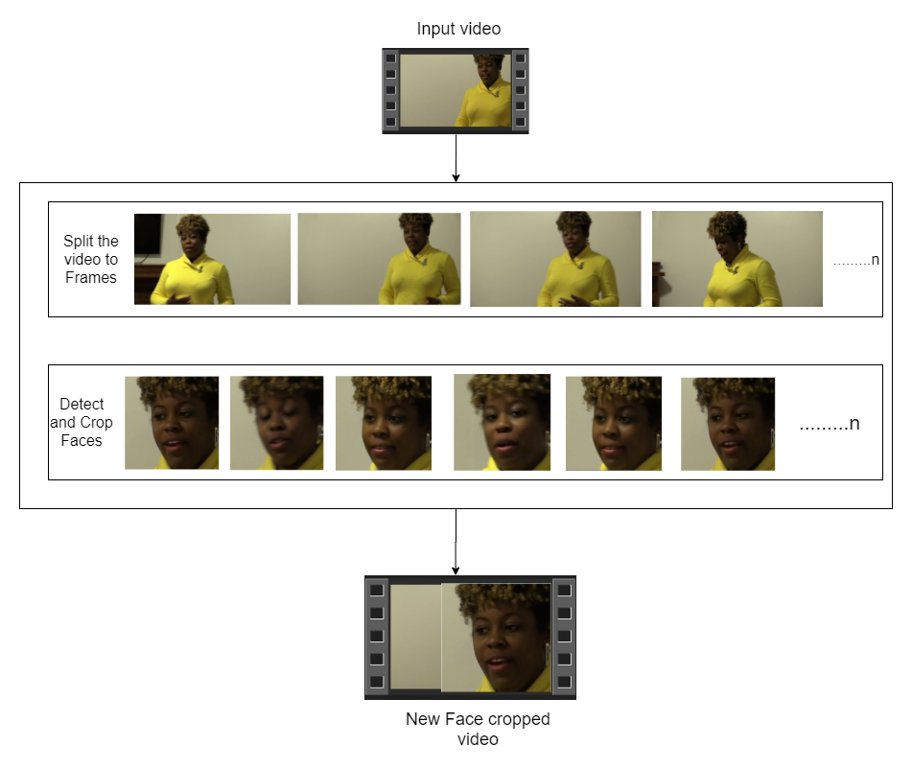

Pre-
processing
Implementation
SPLIT VIDEO INTO FRAMES
FACE DETECTION
5
4
3
2
1
CROPING FACE
CREATING NEW FACE CROPPED VIDEO
SAVING THE FACE CROPPED VIDEO

Slide 16
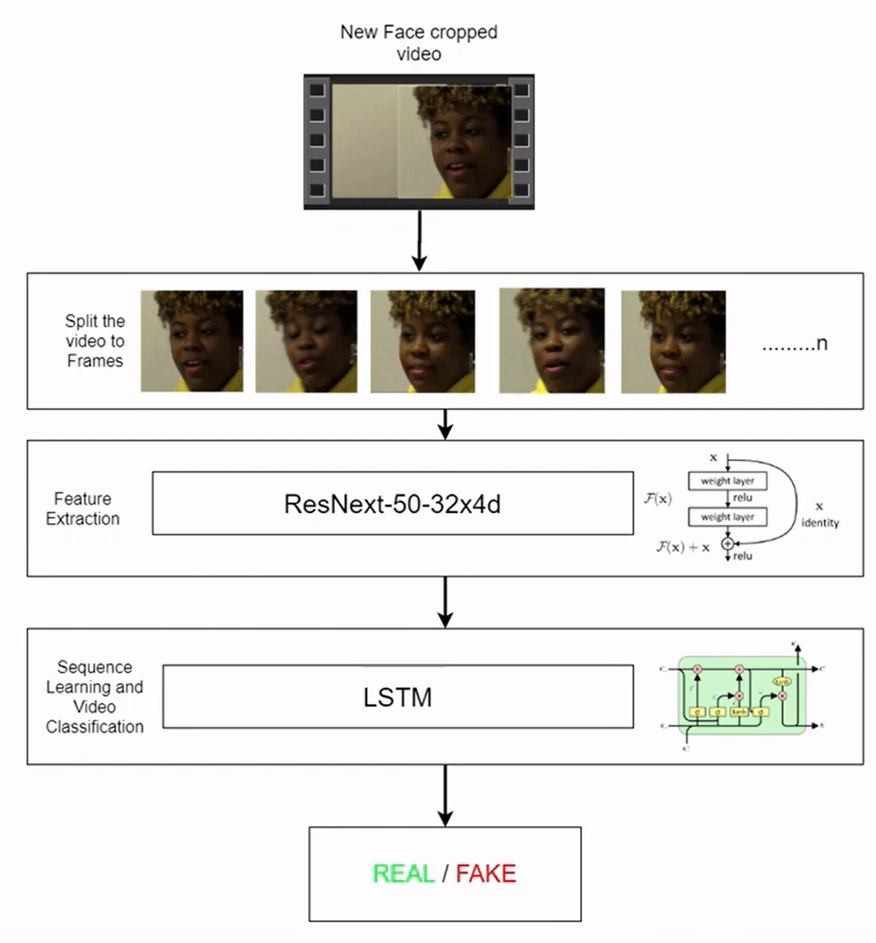
Model Architecture
Implementation

Slide 17
Results
Discussion
Model Name | Dataset | No of Videos | Sequence Length | Accuracy
model_84_acc_10_frames_final_data | Our Dataset | 6000 | 10 | 84. 662519
model_87_acc_20_frames_final_data |  |  | 20 | 87.79160186
model_89_acc_40_frames_final_data |  |  | 40 | 89.3468118195956
model_91_acc_60_frames_final_data |  |  | 60 | 91.5909797822706
model_93_acc_100_frames_final_data |  |  | 100 | 92.4981855883877

Slide 18
Conclusion
We presented a neural network-based approach to classify the video as deep fake or real, along with the confidence of proposed model.
Our method is capable of predicting the output by processing 1 second of video (10 frames per second)with a good accuracy.
We implemented the model by using pre-trained ResNext CNN model to extract the frame level features and LSTM for temporal sequence processing to spot the changes between the t and t-1 frame.
Our model can process the video in the frame sequence of 10,20,40,60,80,100.

Slide 19
References
[1] “Capsule-Forensics Networks for Deepfake Detection” ,Huy H. Nguyen, Junichi Yamagishi & Isao Echizen, https://link.springer.com/chapter/10.1007/978-3-030-87664-7_13
[2] A GAN-Based Model of Deepfake Detection in Social Media, Preeti a*, Manoj Kumar b*, HiteshKumarSharmaa,b, A GAN-Based Model of Deepfake Detection in Social Media – ScienceDirect
[3] Face X-ray for More General Face Forgery Detection Lingzhi Li1∗† Jianmin Bao Ting Zhang2 Hao Yang2 Dong Chen2 Fang Wen2 Baining Guo2 1Peking University 2Microsoft ResearchAsia,https://openaccess.thecvf.com/content_CVPR_2020/papers/Li_Face_X-Ray_for_More_General_Face_Forgery_Detection_CVPR_2020_paper.pdf
[4] FaceForensics++: Learning to Detect Manipulated Facial Images https://github.com/ondyari/FaceForensics
[5] Deep Fake Detection Challenge DataSet. https://www.kaggle.com/c/deepfake-detection-challenge/data
[6] Celeb-DF: A Large-scale Challenging Dataset for DeepFake Forensics, https://github.com/yuezunli/celeb-deepfakeforensics

Slide 20


Slide 21


